Slide 1
Rules of Engagement Moving beyond combat-based quests
Anne Sullivan, Michael Mateas, and Noah Wardrip-Fruin
anne@soe.ucsc.edu
http://users.soe.ucsc.edu/~anne/
18 June 2010
Notes:
I will be presenting my work on the Grail Framework which aims to help designers move beyond combat-based quests.

Slide 2
Motivation
We wish to enable players to have deeper choices within the game narrative.
Notes:
What do we mean by that? (next slide)

Slide 3
Combat Reliance
The main mechanic for choice is through combat.
Meanwhile, narrative is on a fixed trajectory.
Localized choices
Linear story
Localized choices
Linear story
Localized choices
Notes:
Currently in CRPGS, the deepest choices are within the combat systems. Combat has a robust set of systems that have been developed for many years, so this form of interaction is much easier to implement.
Unfortunately, narrative is confined to local, shallow effects to the game world.
To drive home the linear nature of the story, many times this linear story is presented in the form of a cut scene, no interactivity at all.

Slide 4
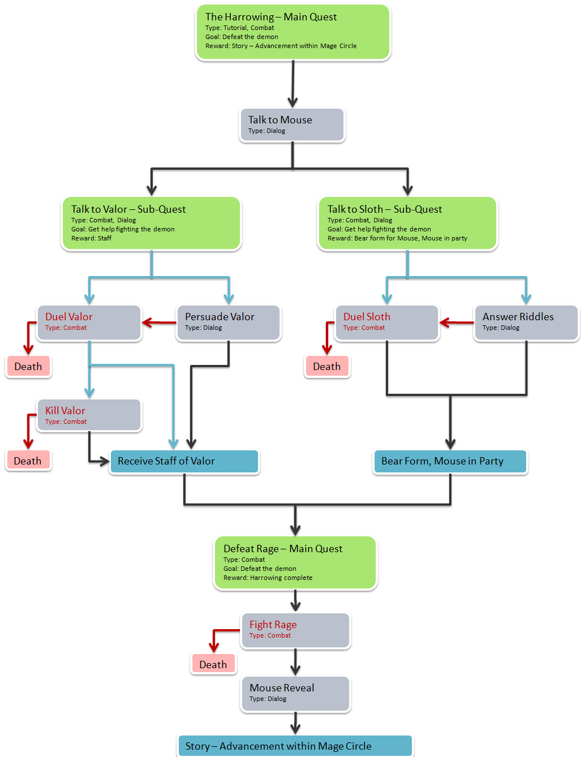
Quests
Players move through narrative in the form of quests.
Notes:
Quests are the mechanic used to guide (or in some cases, dictate) how players move through the story. It is the source of interaction between the player and the story. Therefore, we focus on quests and how to improve them to open up the options available to the player. Here, the blue boxes are pieces of narrative, and the branching shows quests that can be done in parallel.

Slide 5
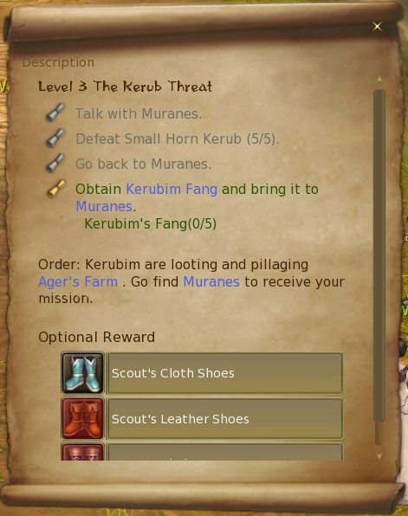
Playable Quests
Quests lack interesting or meaningful choices.
Quests are not playable.
Notes:
Quests in their current form in CRPGs are presented to the player as a list of tasks to perform. This means that the player is not presented any interesting or meaningful choices, and therefore we use the terminology that quests are not playable.
To create playable quests, new game mechanics are necessary. In Josh’s talk, he spoke about creating a “social physics”, we are interested in creating “quest physics”.

Slide 6
The GrailGM
Game
Player
takes actions
Game System
updates
Player State
World State
offers new quests, quest-related actions
GrailGM
monitors
Quest Manager
Quest Library
suggests quests
informs of completed quests
Active Quests
Quest Filter
Active Quest Monitor
Notes:
To address this problem, we created The GrailGM which is a run-time system. The GrailGM (which stands for Game Master, similar to a table-top Game Master) supports the ability to add and modify quests and game objects without requiring the designer to touch every other object. This is a necessary step towards adding playability to quests; more options means more complexity.

Slide 7
The GrailGM
The GrailGM selects pre-authored quest pieces and re-combines them based on player actions.
NPC
NPC
NPC
Quest Goal
Solution
Solution
Solution
Notes:
We first break quests into components which allows for more dynamic recombinations in reaction to the player. I will talk about each part a bit more in detail.

Slide 8
Quest Goals
Quest goals are defined as the game state change required for the quest to be considered complete.
NPC
NPC
NPC
Quest Goal
Solution
Solution
Solution
Notes:
One of the components we have broken out is quest goals. (definition) For instance, a quest to befriend a particular NPC would be completed when the player has achieved the friend status with an NPC.
Quest goals are designed with a set of preconditions. The GrailGM’s QuestFilter searches the Quest Library for a list of quests goals with the preconditions met.
Currently, it picks one randomly, but in the future, a smarter selection method will be employed.

Slide 9
NPCs
Quests are no longer tied to particular NPCs. This allows the NPCs to play a larger part in the game interaction.
NPC
NPC
NPC
Quest Goal
Solution
Solution
Solution
Notes:
Since quests no longer come from a particular NPC, this allows for interactions with the NPCs to be part of the player-driving story. For instance, the player’s interactions with different NPCs can be used for future quests.

Slide 10
Solutions
Solutions are the available actions that the player may take to complete the quest goal.
NPC
NPC
NPC
Quest Goal
Solution
Solution
Solution
Notes:
(definition) For the quest goal of befriending an NPC, solutions available may be to help them with a specific problem (possibly leading to a sub-quest), spend time working with the NPC, or get introduced to them by a mutual friend.

Slide 11
Demo
Putting it all together - demo time!
NPC
NPC
NPC
Quest Goal
Solution
Solution
Solution
Notes:
The demo is a small prototype of the system. The player is in a hotel room, and they currently do not have a quest goal. Through exploration they will receive their next implicit quest goal. As a note, while this prototype uses implicit quest goals instead of explicitly stating them, this is not a requirement for the system.

Slide 12
Conclusion
By generating quests in response to player’s actions, they are able to have deeper choices within the game narrative.
Notes:
Adding options keeps the player engaged as they are offered interesting choices at each quest, instead of the same single solution that is common in many modern-day CRPGs.

Slide 13
Thank You
Questions?
Anne Sullivan
anne@soe.ucsc.edu
http://soe.ucsc.edu/~anne/
Blizzard, World of Warcraft, 2004

Slide 14
The GrailGM
Game
Player
takes actions
Game System
updates
Player State
World State
offers new quests, quest-related actions
GrailGM
monitors
Quest Manager
Quest Library
suggests quests
informs of completed quests
Active Quests
Quest Filter
Active Quest Monitor

Slide 15
The GrailGM
Game
Player
takes actions
Game System
offers new quests, quest-related actions
updates
Player State
World State
GrailGM
monitors
Quest Manager
Quest Library
suggests quests
informs of completed quests
Active Quests
Quest Filter
Active Quest Monitor

Slide 16
The Grail Framework
The GrailGM allows for quests to be decoupled from a specific NPC.
This allows for NPC / player relationships to become part of the actions available and to be part of the developing story.
Notes:
I’m playing an RPG, walking down the road minding my own business. When suddenly…

